Slide 1
Financial Chatbot
GUAN Xin ZHANG Yanlin

Slide 2
Plan
Design
2022.11.28-2022.12.31: Design questions scripts and develop an auto-test procedure
Collect
2023.1.1-2023.1.15: Collect data(banks, investment firms, and insurance companies in HK)
Clarify
2023.1.15-2023.2.28: Clarify the main problems, build evaluation paradigms(based on SOTA technology)

Slide 3
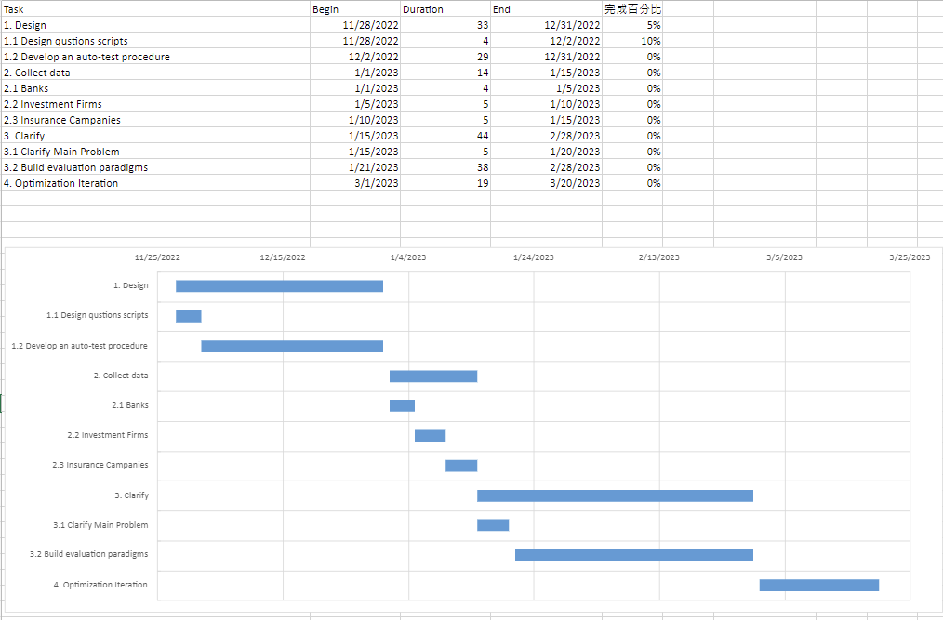

Slide 4
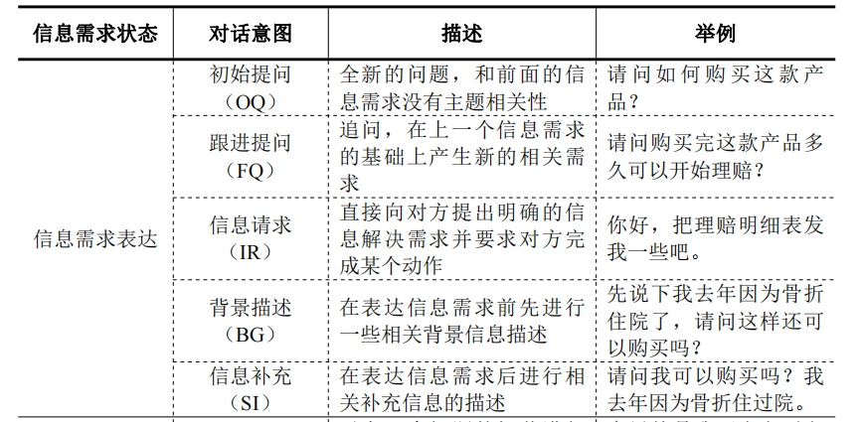
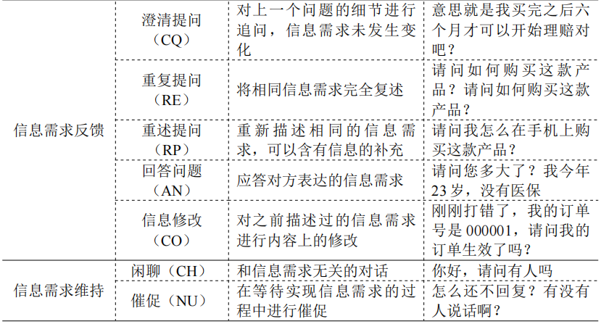
Reference questions

Slide 5
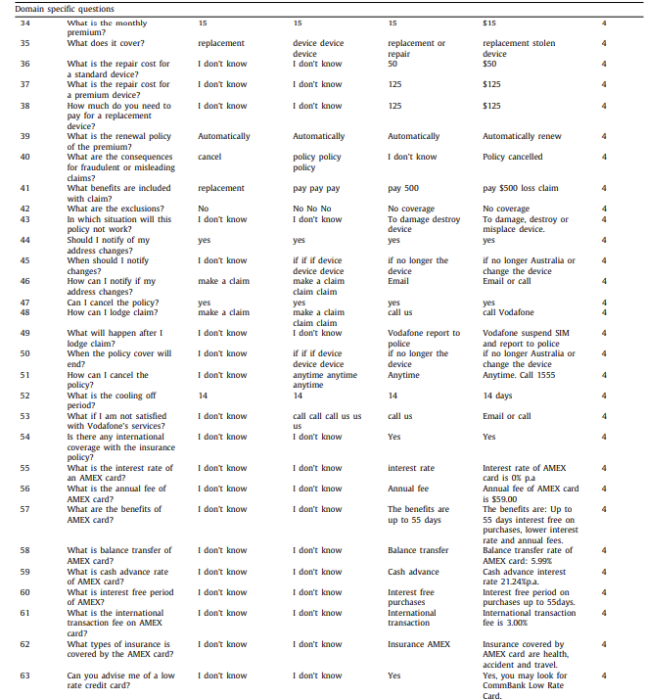
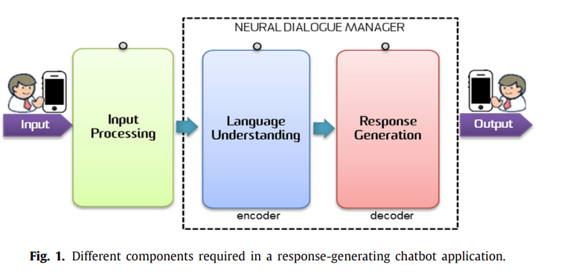
Reference questions
Intellibot

Slide 6
Quality dimensions
Prediction accuracy, i.e., how good a recommender system is in identifying items that are relevant for users;
Item coverage, i.e., how many items of the catalog are recommended by the system;
Novelty, i.e., the capability of a system to help users discover new content;
Serendipity, i.e., the ability of a system to recommend surprising, yet relevant content;
Diversity, i.e., the capability of a system to create diversified, yet relevant recommendation lists;

Slide 7
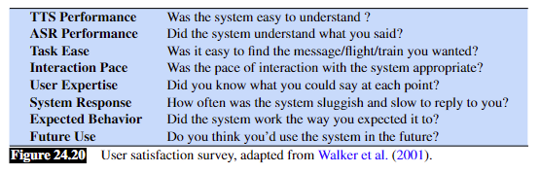
Automatic evaluations
adversarial evaluation (Bowman et al. 2016, Kannan and Vinyals 2016, Li et al. 2017)
Task completion success
Efficiency cost

Slide 8
Evaluation question design
Level 1：
Efficiency: speed of answering questions, measure by time to answer questions(0.5min/per unit).
Accuracy: answers correct or not.
Synonym recognition: e.g., Discount Scheme/ Preferential Scheme
Mutate punctuation
Tokenisation recognition
……
Level 2:
Diversity: coverage of items
…

Slide 9
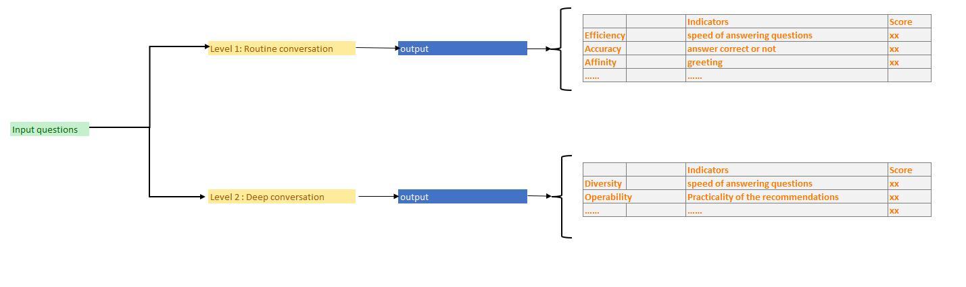
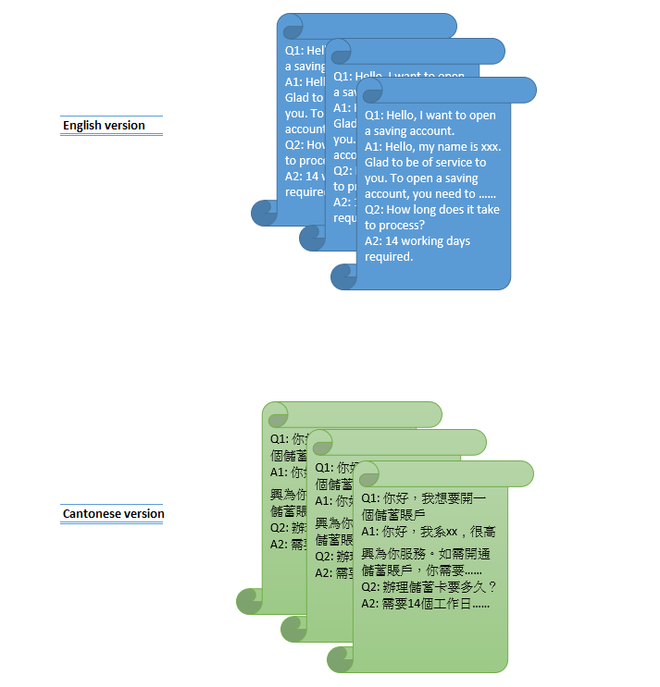

Slide 10

2021 Whitepaper on AI
“In reality, however, the Chatbots deployed by many of the banks we surveyed are still at the development stage, only offering basic banking services such as information about balances and account details.”

Slide 11
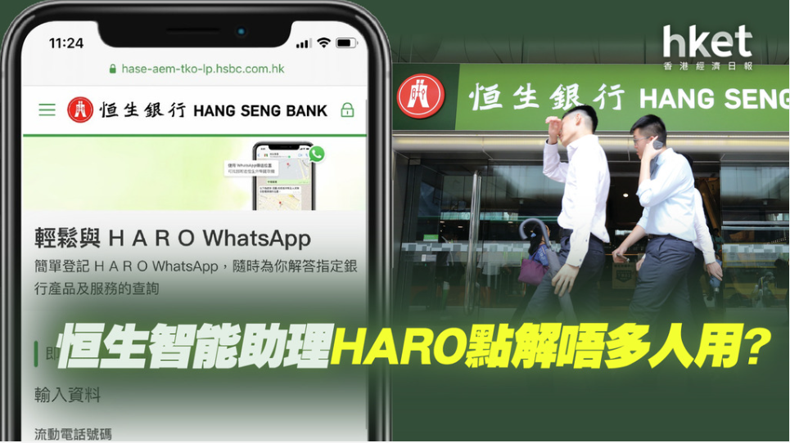
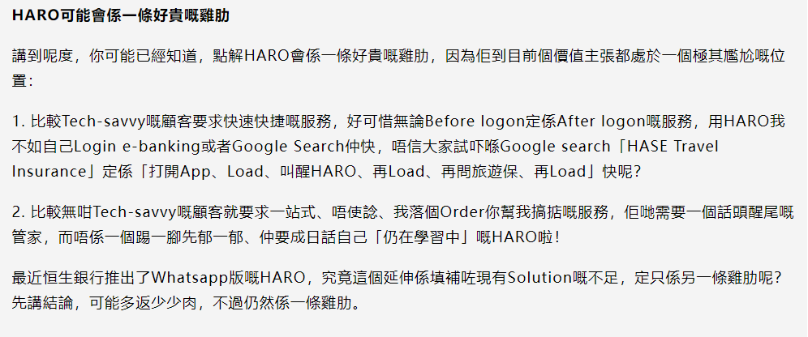
HK BANK CHATBOT
Hang Seng :HARO, DORI(facebook)
Standard Chartered Bank : Kaisisto
HSBC: Amy

Slide 12
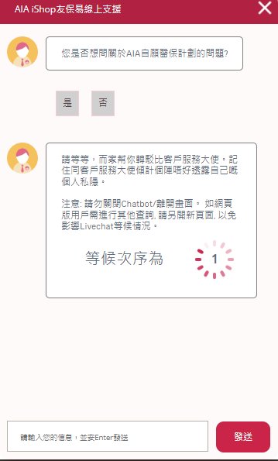
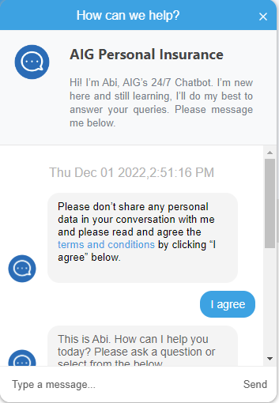
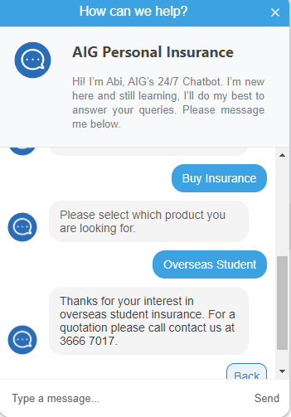
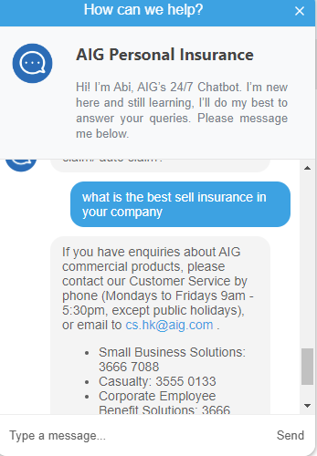
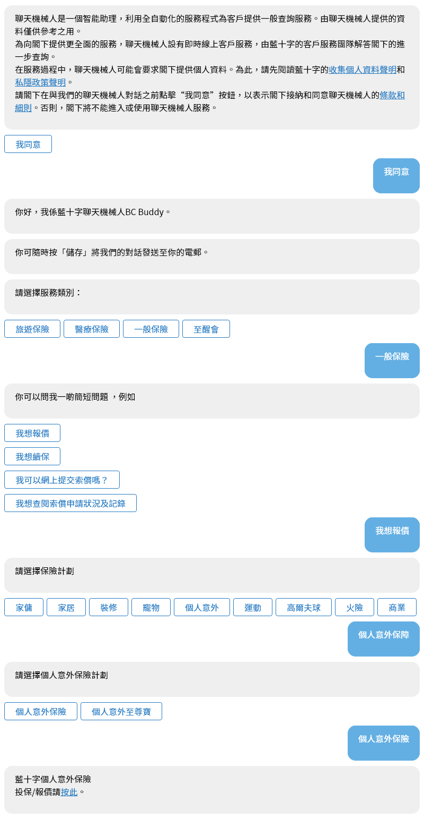
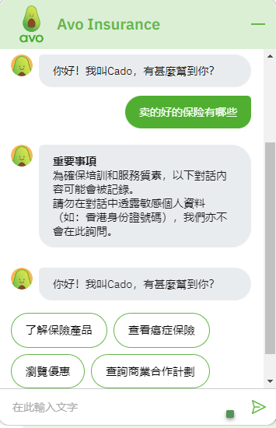
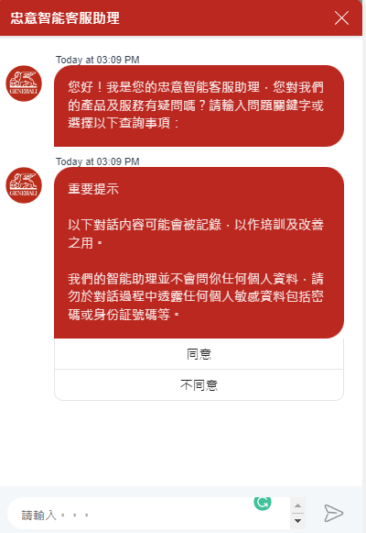
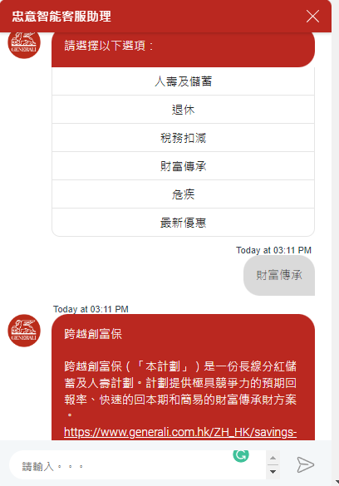
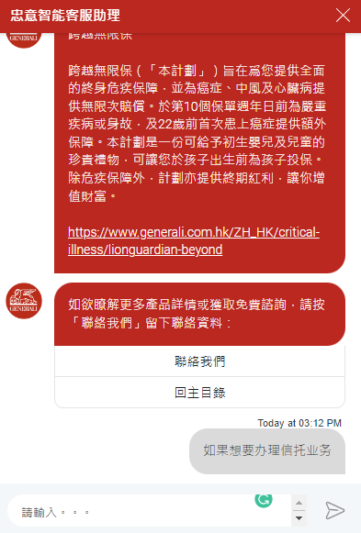
Online Insurance chatbot investigation
Button-based chatbots
www.aia.com.hk
Long time no answer
www.aig.com.hk
https://www.bluecross.com.hk/ch/Home/Index
www.heyavo.com
www.generali.com.hk
No answer

Slide 13
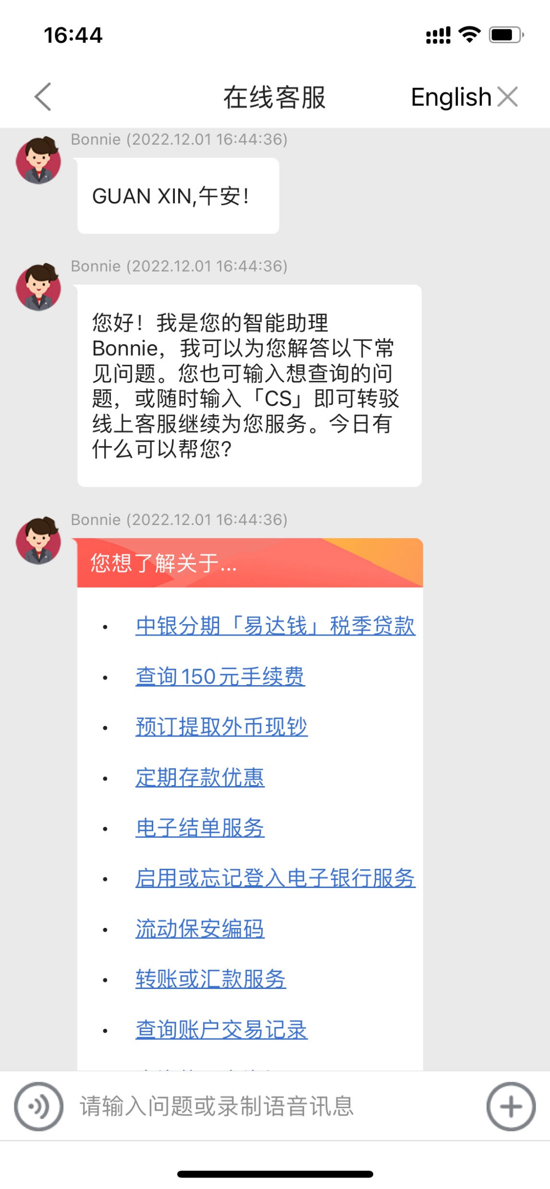
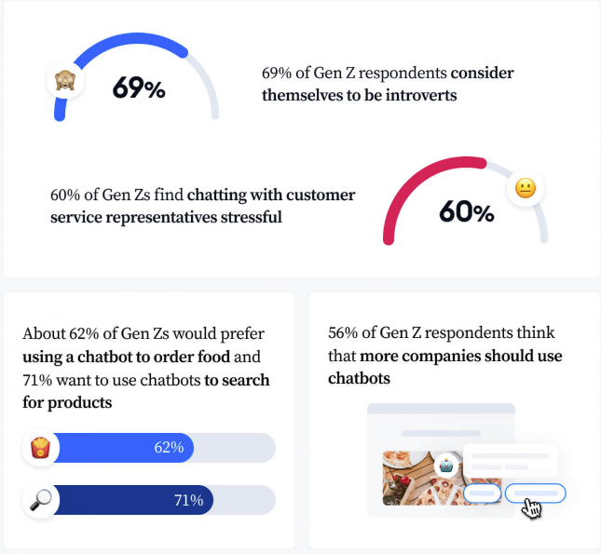
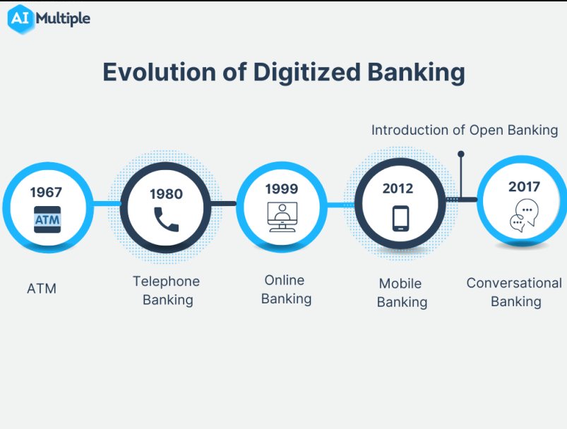
Financial Chatbot development
High cost->plugin-based chatbot
Mainly mobile orientated
Aging society
Compliance and security
https://www.giosg.com/blog/ai-chatbot
https://research.aimultiple.com/banking-chatbot/

Slide 14
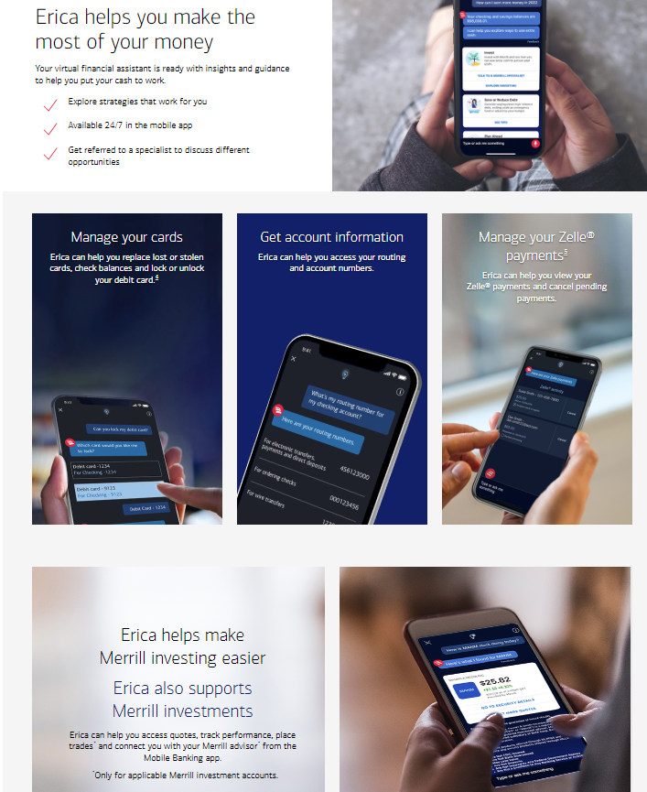
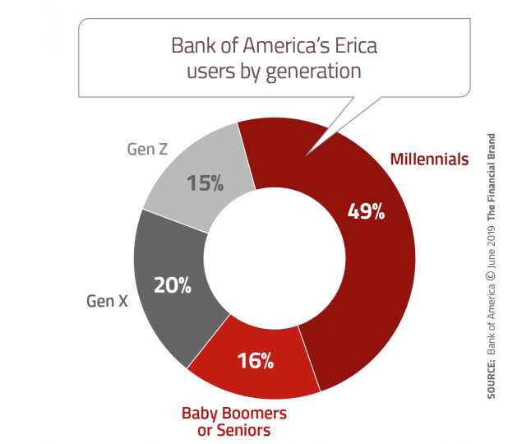
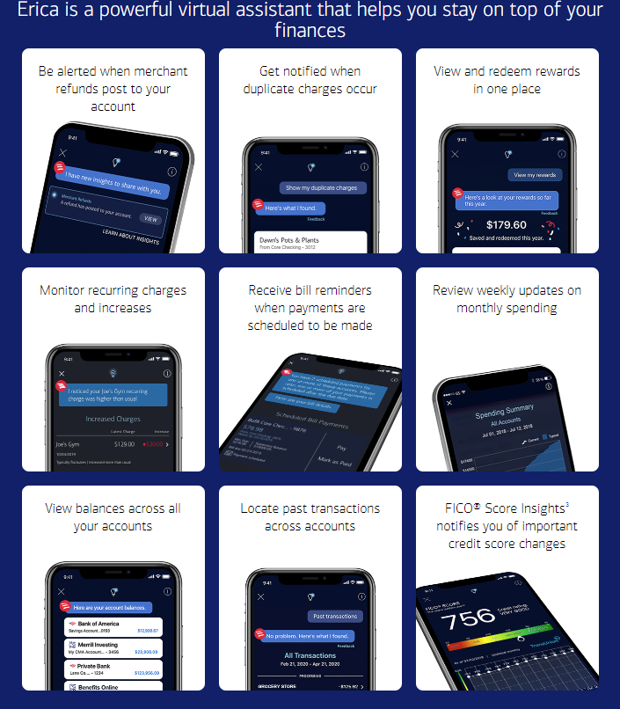
Bank of America: Erica
https://thefinancialbrand.com/news/banking-technology/bank-of-america-chatbot-erica-retail-banking-virtual-assistant-84350/

Slide 15
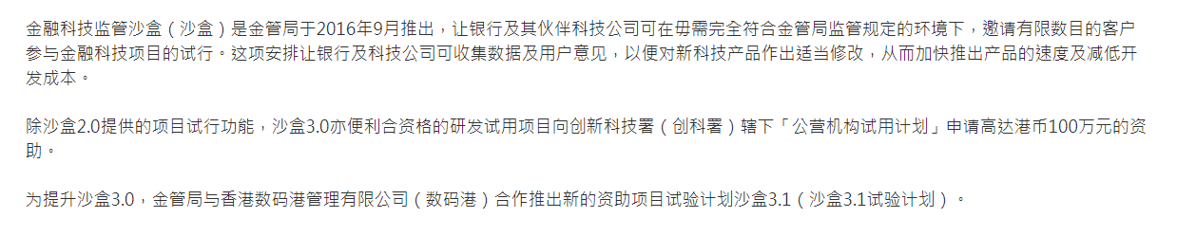
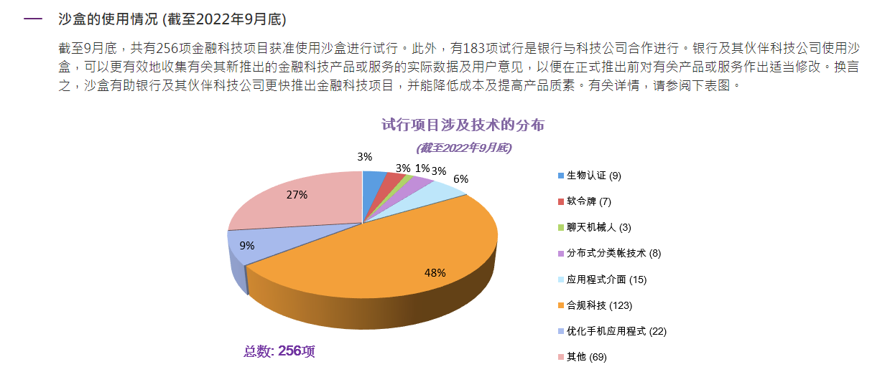
Fintech Supervisory Sandbox (FSS) From Hong Kong Monetary Authority (HKMA)

Slide 16
Conclusion
Diversity
AGE

Slide 17
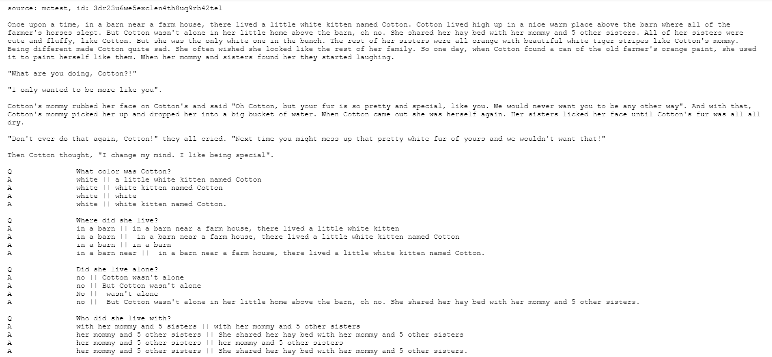
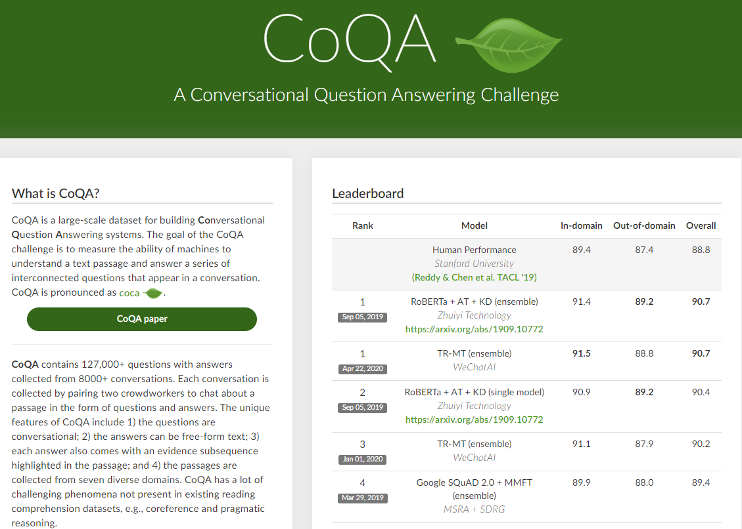
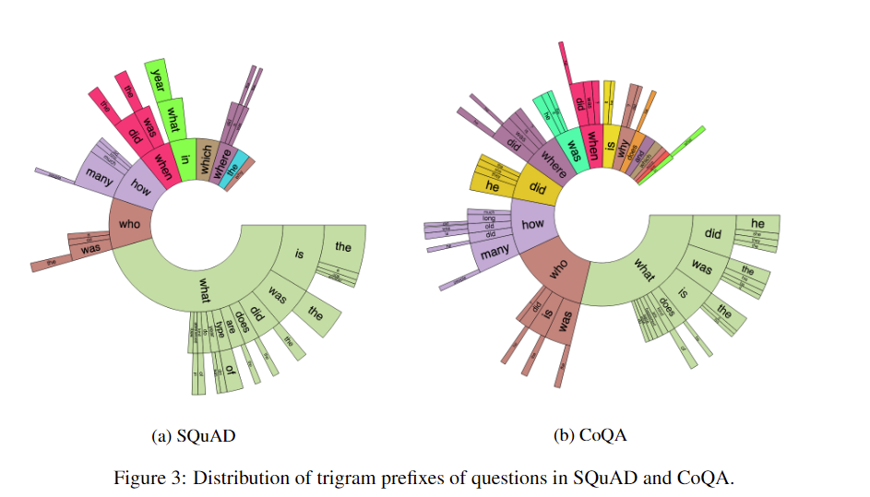
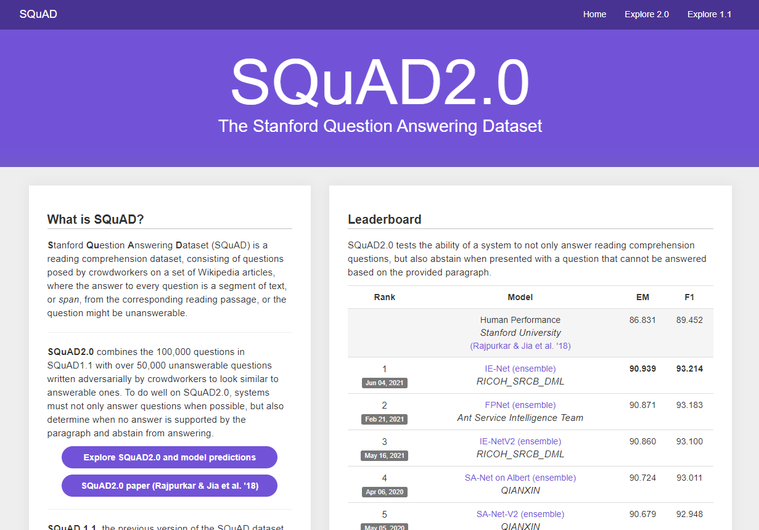
https://stanfordnlp.github.io/coqa/
https://blog.csdn.net/cindy_1102/article/details/88560048

Slide 18
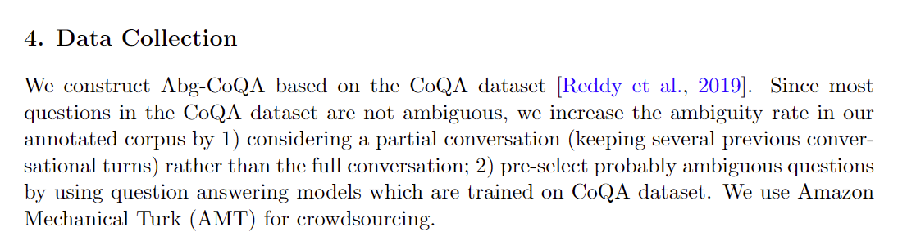
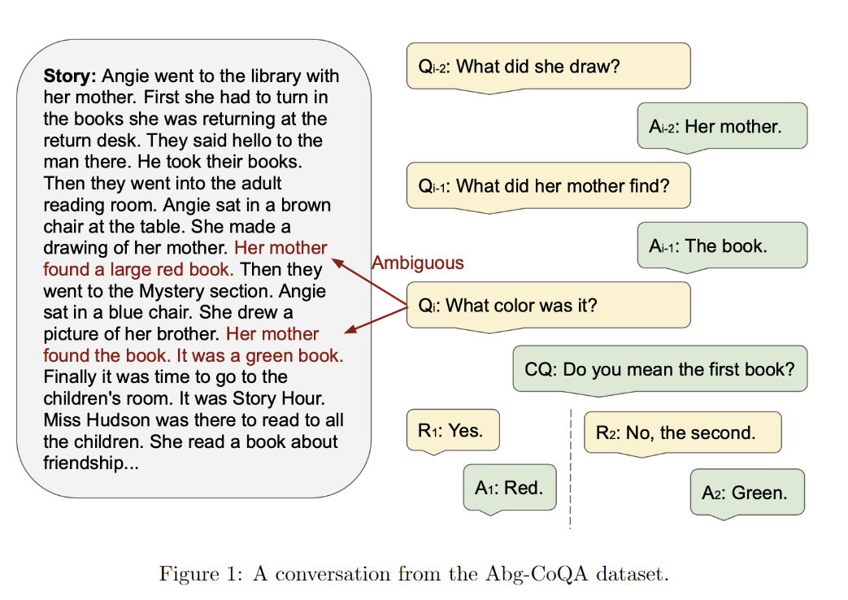
Abg-CoQA:Clarifying Ambiguity in Conversational Question Answering

Slide 19
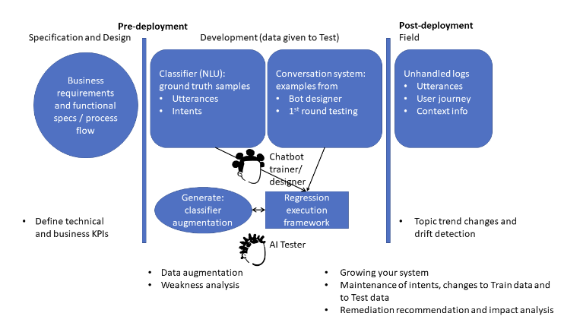
High-quality conversational system (IBM, 28 Apr 2022)
Input coverage model1: Natural language variations
Input coverage model2: Natural language classifier decision boundaries
CT (Combinatorial Testing)
Data generation: Data augmentation by LAMBADA
Complexity measure: FreaAI
Data: CQA, a COVID-19 Questions and Answers chatbot data (Tepper et al. 2020) and banking77 a banking related queries chatbot data (Casanueva et al. 2020)
chrome-extension://bocbaocobfecmglnmeaeppambideimao/pdf/viewer.html?file=https%3A%2F%2Farxiv.org%2Fpdf%2F2204.13043.pdf

Slide 20
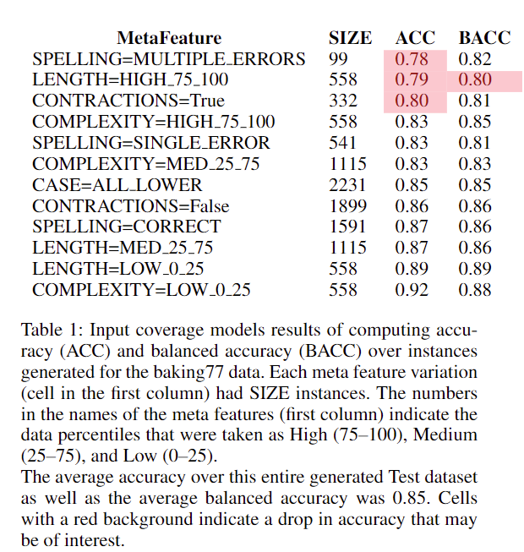
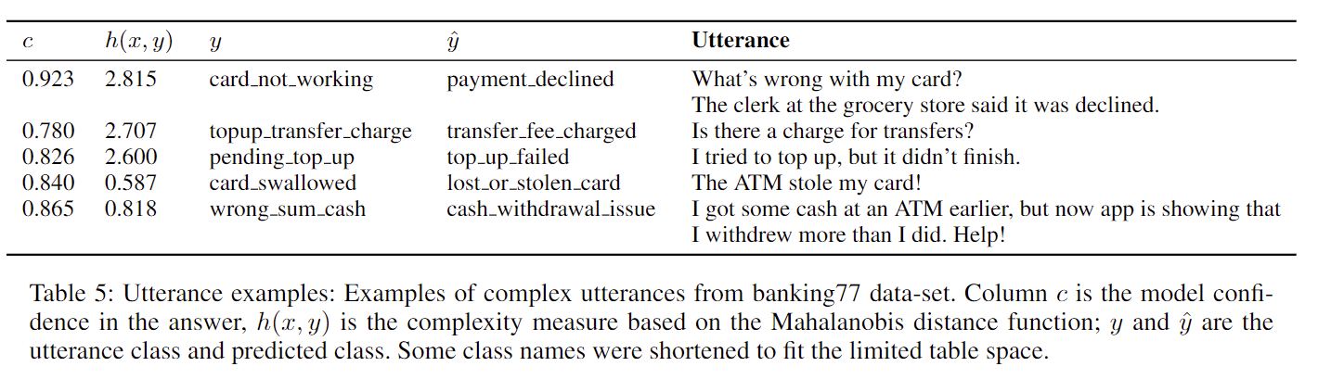

Slide 21
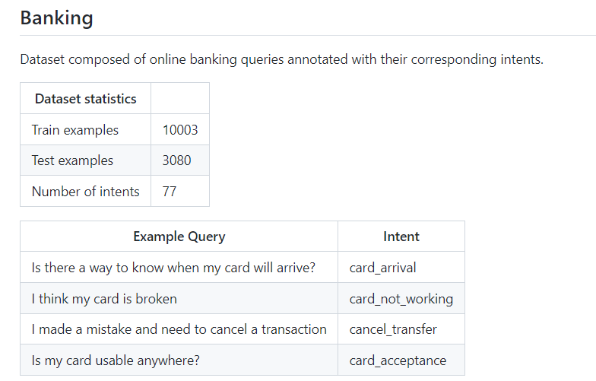
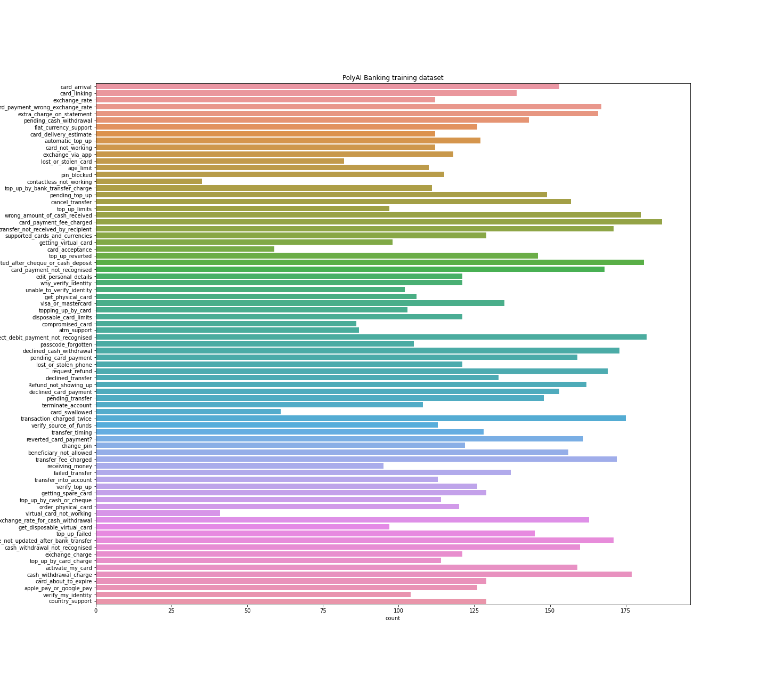
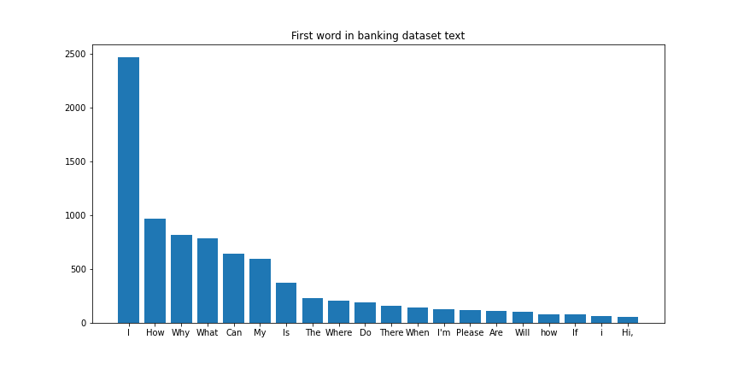
PolyAI
https://zhuanlan.zhihu.com/p/272614460

Slide 22
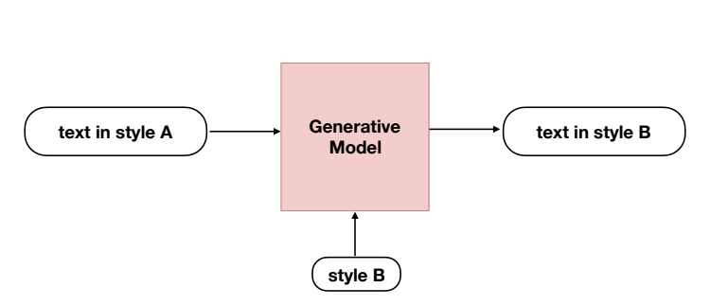
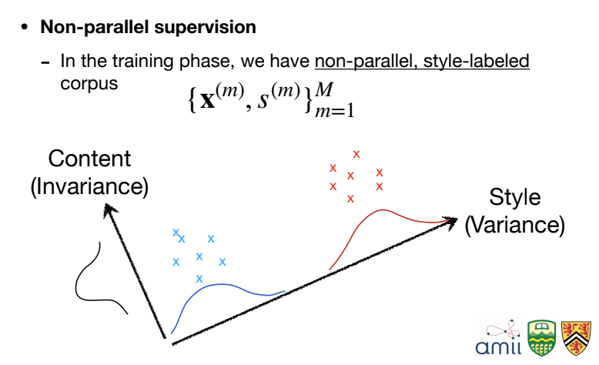
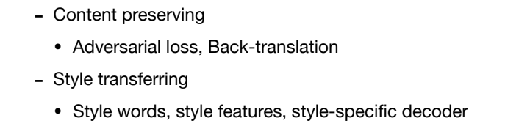
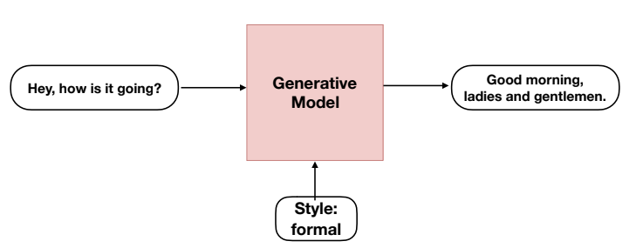
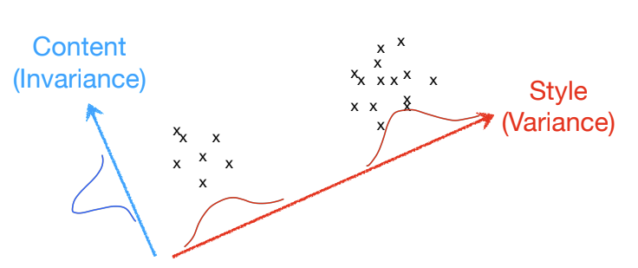
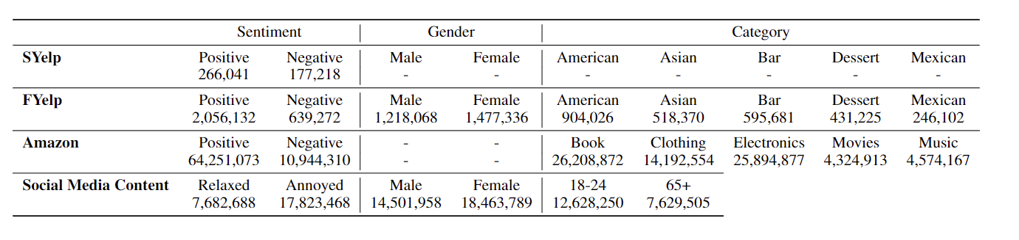
NLG: Style-transfer text generation
given text written in source style, generate text in the target style
- Preserve the invariance
- Change the variance
https://github.com/fuzhenxin/Style-Transfer-in-Text
https://blog.csdn.net/bqw18744018044/article/details/122016459

Slide 23
NLG: Style-transfer text generation
Formality -> Informality
Age: 18-24 -> 65+
Back translation, random deletion, random addition, synonym substitution

Slide 24
StylePTB: A Compositional Benchmark for Fine-grained Controllable Text Style Transfer
3 letter style codes:
TFU == To Future
TPA == To Past
TPR == To Present
ATP == Active To Passive
PTA == Passive To Active
PFB == PP Front To Back
PBF == PP Back To Front
IAD == Information Addition
ARR == ADJ/ADV Remooval
SBR == Substatement Removal
PPR == PP Removal
AEM == ADJ Emphasis
VEM == Verb Emphasis
NSR == Noun Synonym Replacement
ASR == Adjective Synonym Replacement
VSR == Verb Synonym Replacement
NAR == Noun Antonym Replacement
AAR == Adjective Antonym Replacement
VAR == Verb Antonym Replacement
LFS == Least Frequent Synonym Replacement
MFS == Most Frequent Synonym Replacement
https://github.com/lvyiwei1/StylePTB/

Slide 25
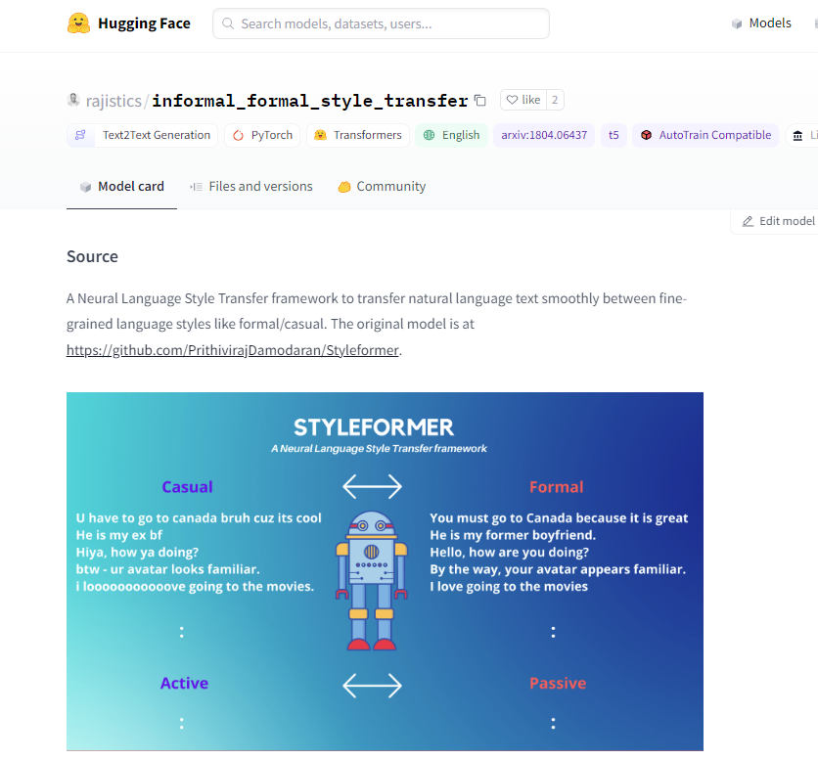
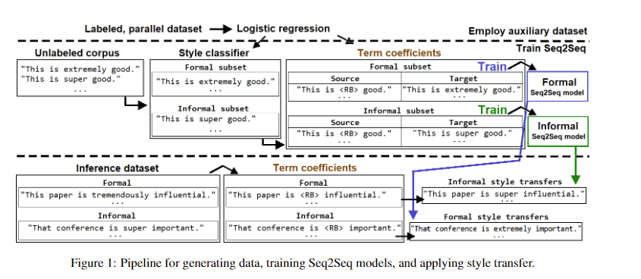
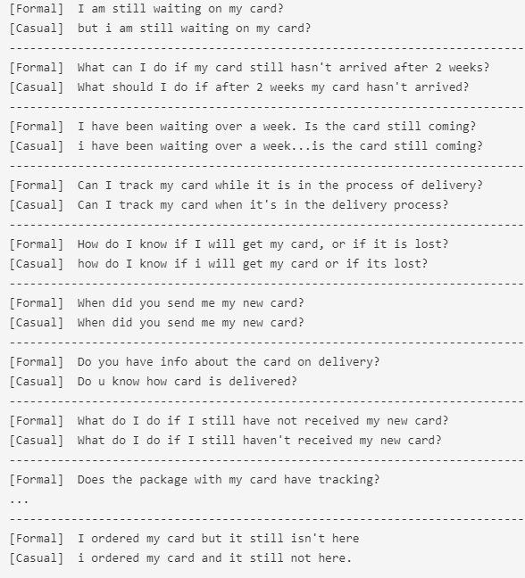
Banking dataset test
Training Dataset
- The Yahoo Formality Dataset was obtained from (Rao and Tetreault, 2018) 106k formal-informal pairs of sentences
- The TV-Shows Datasets are the scripts of 5 popular TV-shows from the 1990’s and 2000’s (Friends, Futurama, Seinfeld, Southpark, Stargate SG-1), with 420k sentences in total. - The Slate Star Codex :3.2 mil- lion sentences from comments in the online forum Slate Star Codex(SSC), from 2013 to 2019
https://github.com/PrithivirajDamodaran/Styleformer

Slide 26
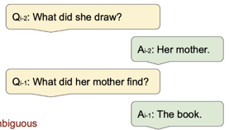
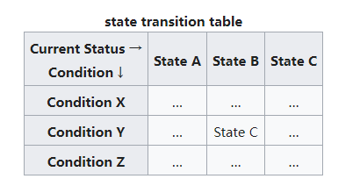








Answers | $$y$$ | $$\hat{y}$$
$$A_{11}$$ | Card_arrival | Card_arrival
$$A_{12}$$ | card_not_working | cancel_transfer
$$A_{13}$$ | card_acceptance | Card_arrival
User intent detection
Conversation Flow
0.1
$$A_{11}$$
$$A_{12}$$
$$A_{14}$$
0.9
0.4
$$Q_{11}$$
$$Q_{12}$$
0.6
$$A_{13}$$
State machine

Slide 27


Microsoft/Facebook Chatbot open source

Slide 28

Identify ambiguous utterances
Ambiguous queries: multiple distinct interpretations (Clarke et al.)
faceted queries: under-speciied queries with subtopics
Similar Question Model (SQM)

Slide 29
Synthetic training data
Google: people also asked
query = bank name + general questions
Hot topic in local forum: Discuss.com.hk/baby-kingdom
Query = bank name
Noisy chat content(Cantonese)
ChatGPT: Automatic dialogue generation

Slide 30

Discuss.com.hk scrape
Query keywords:
Bank name （16）
Bank name + bank services
Insurance company
Time: 2009-2022
50 pages for each query searching results

Slide 31




Turn to dialogue
Dialogue

Slide 32

Question categories classification
Who: 邊個、 谁、 哪个
What: 乜嘢/做乜
When: 几时，幾時，什么时候
Where： 哪，邊度
Why : 點解
How: 點样
Do you know: 識唔識、 知不知（道）
Is it… : 是否、是不是、系唔系
chrome-extension://bocbaocobfecmglnmeaeppambideimao/pdf/viewer.html?file=https%3A%2F%2Fdl.acm.org%2Fdoi%2Fpdf%2F10.1145%2F3534965

Slide 33

Examples from Discuss

Slide 34
Cantonese Corpus
2022.12.23

Slide 35



Slide 36



CUHK: Hong Kong Cantonese Child Language Corpus (CANCORP)
8 Cantonese-speaking children, 1 year
http://www.arts.cuhk.edu.hk/~lal/corpora.html

Slide 37


https://humanum.arts.cuhk.edu.hk/Lexis/lexi-can/

Slide 38


English Loanwords in Hong Kong Cantonese收錄700個外來語與廣東話的網上詞彙語料庫
Polyu
https://chaaklau.github.io/elw/

Slide 39

HKUST: Bible

Slide 40

EDUHK
https://hkcc.eduhk.hk/v1/corpus/word_concordance.php?wordid=9483

Slide 41


Wheaton College, Hang Seng University of Hong Kong, Education University of Hong Kong
https://github.com/jacksonllee/pycantonese

Slide 42
Forum Special words
大猫，狮子（银行）- 中行
恒仔 - 恒生
Ching - 师兄
伏 - 坑

Slide 43
Posts suspected of illegal activity
Money laundering

Slide 44


Good job of translation from Cantonese to Mandarin

Slide 45


Wrong translation due to wrong input words
Correct

Slide 46
Slangs
Wrong words

Slide 47


Fail to detect slangs

Slide 48



買野-购物，买东西 无法识别如此口语化的词语
Fail to Turn to formality

Slide 49



Bing vs Youdao: Bing is better

Slide 50

粤语口语词汇表

Slide 51

BERT-Multilingual: without Cantonese
Cantonese Input
English Input
Toxic text Identification
①Typical questions
②Looking for people with similar experiences
Question category Identification
Emotion Identification(CAN)
Compare
Emotion Identification (EN)

Slide 52

Posts organized as conversation trees
Downloaded from http://direct.mit.edu/coli/article-pdf/44/4/719/1809916/coli_a_00335.pdf by guest on 22 December 2022

Slide 53
Questions in Discuss.com.hk
Typical questions
Looking for people with similar experiences
Strengthen answers by referenced other people experiences

Slide 54

Automatic Generation of Large-scale Multi-turn Dialogues for Forum websites posts

Slide 55

Reverse Dialogue Generator(RDG)

Slide 56

EVPI (Expected Value of Perfect Information)
describes the maximum expectation for a random event when one has its full information.
for each question q there is a range of possible responses, each of which provides a different degree of usefulness of information.
The expected value of the benefit from this series of responses is the EVPI for that question.
Help user ask good question:
offer enough information
chrome-extension://bocbaocobfecmglnmeaeppambideimao/pdf/viewer.html?file=https%3A%2F%2Farxiv.org%2Fpdf%2F1805.04655.pdf
https://tech.sina.com.cn/roll/2018-06-16/doc-ihcyszsa2264426.shtml
Notes:
Clarify whether the chatbot will help to ask the question

